Slide 1
the-Sergio
Jacob Buchowiecki, Andy Montes,
Claude Phan, Roberto Rodriquez

Slide 2






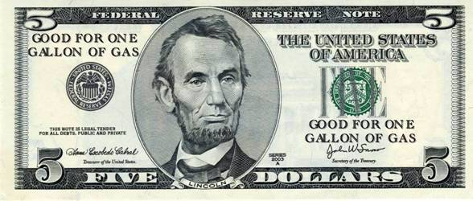


Notes:
5 dollars, and many choices, what to choose?

Slide 3

Notes:
….At last!... You jump up with joy! It’s lunch time another boy yelled! But wait….mom only gave you $5 for lunch….with so many choices and so little time…what is a young boy supposed to do?

Slide 4

BudgetGrubbin

Slide 5


Business Model
Mobile and Website Ads
+
Marketing for Campus Restaurants
+
No User subscription Fees
=

Slide 6

Estimated Market Size & Value
~22,000 students at Cal Poly Pomona
At .005 (half a cent per view), expected to profit $5.00 per 1,000 view 5 X 22,000 = $110 per day! $110 x 55 days = $6,050 per quarter
$100 marketing contract per quarter for each location on campus 22 locations X $100 = $2,200 per quarter
Annual profit: $6,600 per year from marketing + $18,150 per year from Ads = $24,750 Annual Profit

Slide 7

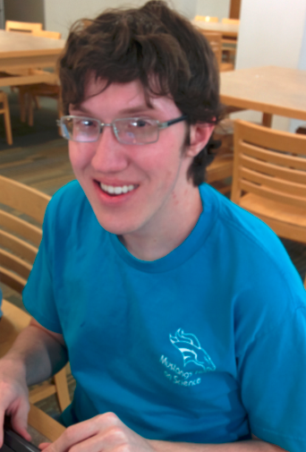
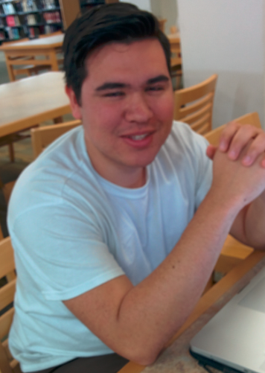
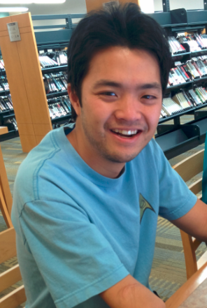
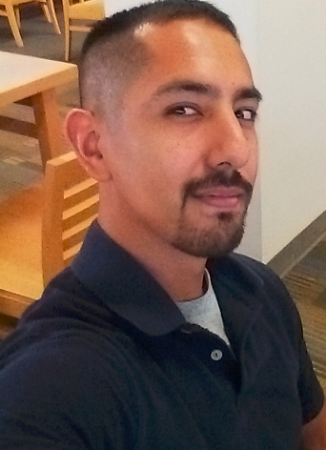
Meet the-Sergio
 | Jacob Buchowiecki | Andy Montes | Claude Phan | Roberto Rodriguez
Hometown | Rancho Santa Margarita, CA | Orange, CA | Diamond Bar, CA | Fillmore, CA
CS interests | Graphics, audio | Mobile development | Making math games | C++, computer architecture
Outside interests | Anything else | Traveling, sports | Video games | Sports, games
Notes:
Year,

Slide 8
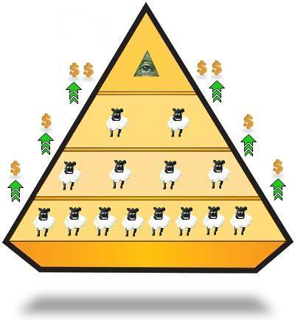
Money Raising
$400,000 initial funding
Expanding BudgetGrubbin to other schools
Robust database system that can support live updates
Marketing + advertising
Travel expenses

Slide 9

Break Even
$2,000 per school
Travel expenses + discovery and requirements gathering
Projected Revenue growth
10 Schools first year
$300,000

